Slide 1
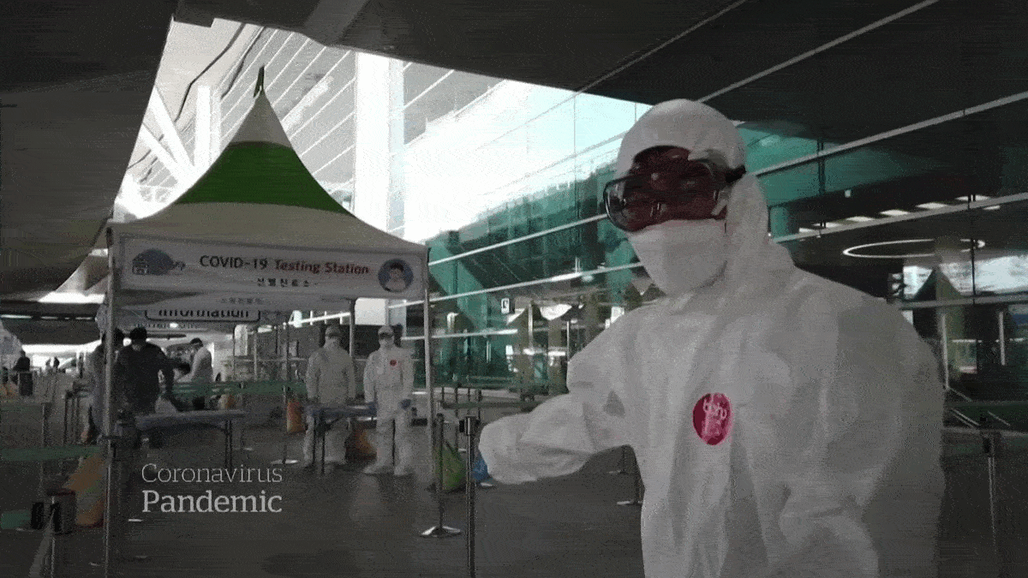
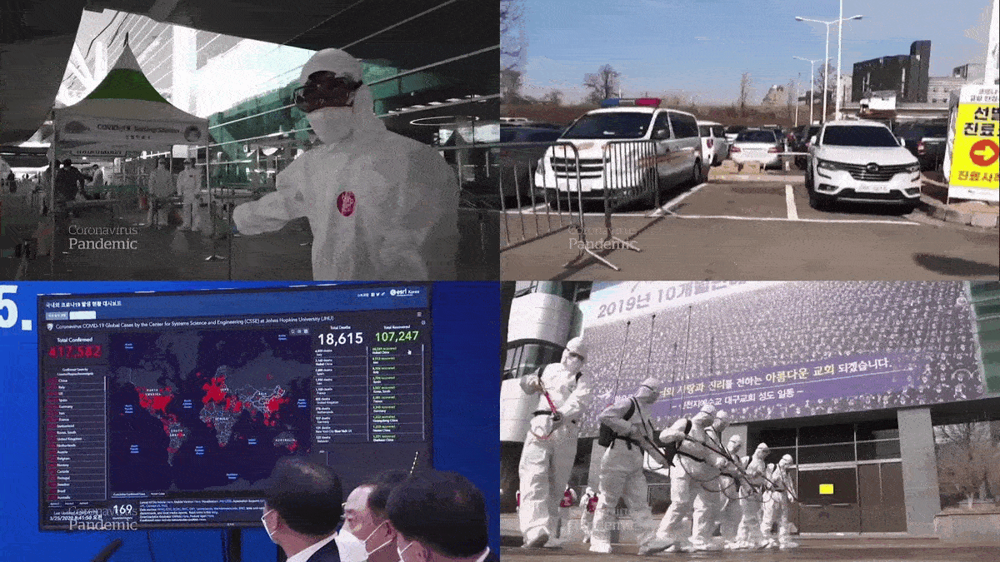
Notes:
0)
1) South Korea never experienced a full-fledged lockdown, as it took other measures to quickly control the spread of the virus.

Slide 2

₩330,000,000,000
The Show Must Go On
Notes:
0) As a result, cultural life rapidly returned to a semblance of normality. They have had a full run of Cats and The Phantom of the Opera closed for just a few weeks. And they have a government that cares about their artists.
1) South Korea’s government provided ₩330,000,000,000 or $280 million in support to cultural institutions. Several times, the government provided half-price tickets to encourage audiences to return to the theatres, causing a surge in attendance. They were one of a few countries to have kept theatres open. The only account I could think of where theatre was still running were some Latin American countries. And its anecdotal from talking to those in Brazil and Argentina, whose government, like ours, is not the most responsible.
From Soovin’s account: They barely even fill 30% of the seats so she knew that this is not going to work. If they’re going to have another surge, the audience's fear is powerful, so they need to find a way to expand the possibilities and the potentials of this virtual medium. They streamed shows around Korea and the world.
These clips are from a documentary titled “The Show Must Go On.”

Slide 3
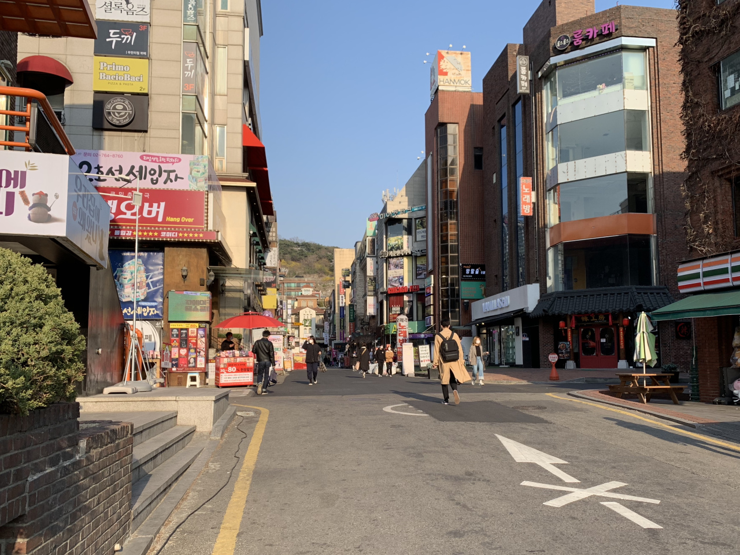
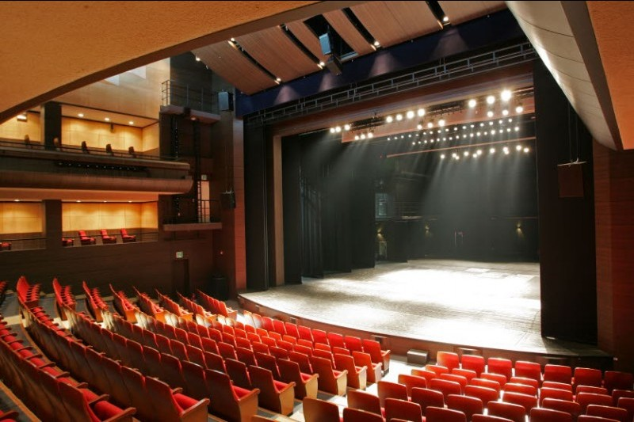
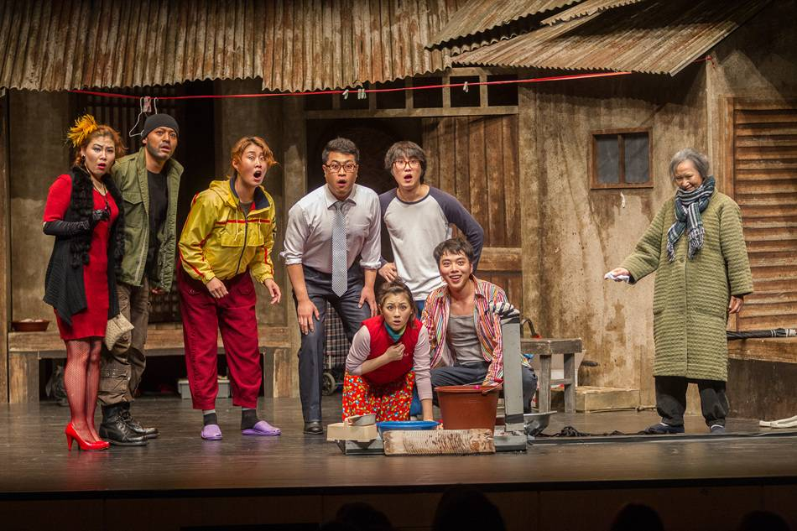
Daehangno
Notes:
(If there are 3 minutes left) Since we have enough time, I’ll give you a tour of Daehangno in Seoul. This neighborhood is equivalent to Off-Broadway.
We don’t have time to address these. But you should visit when you get the chance.

Slide 4
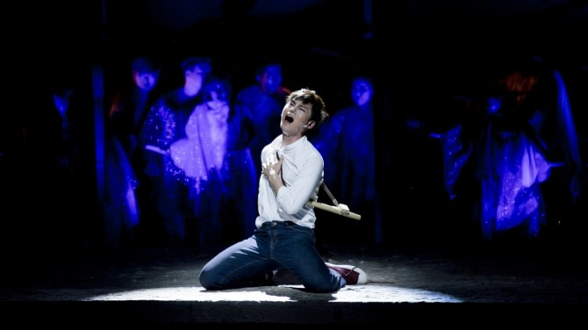
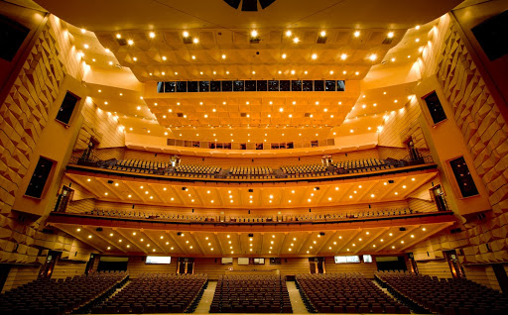
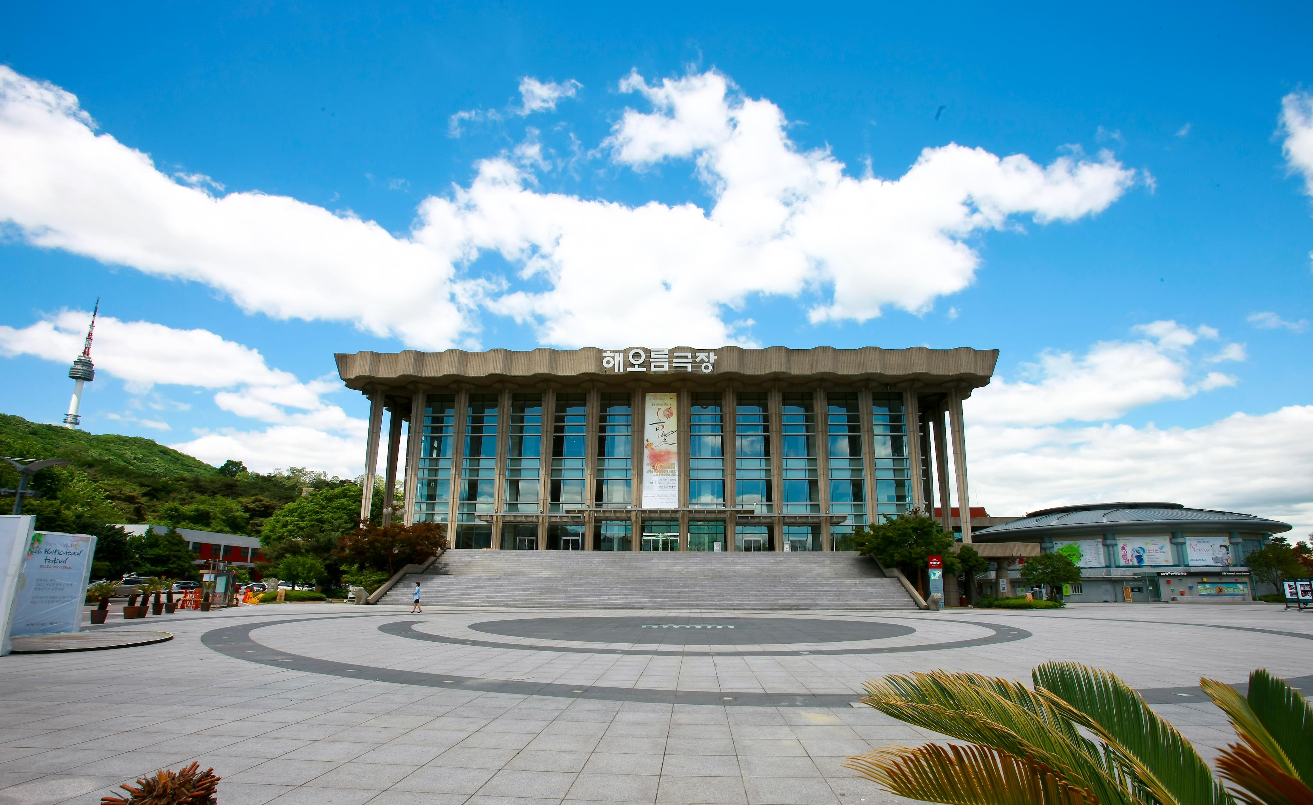
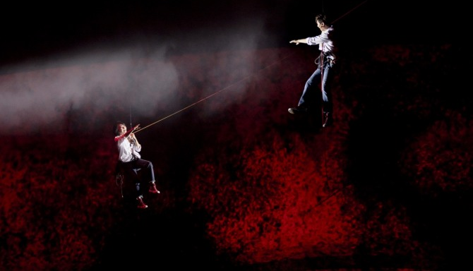
국립극장
Notes:
This is the National Theatre of Korea.
You don’t have to set foot on the peninsula to enjoy K-Theatre. There is a new musical headed to Broadway in 2022 called: K-Pop, composed by my musical writing colleague, Helen Park.

Slide 5
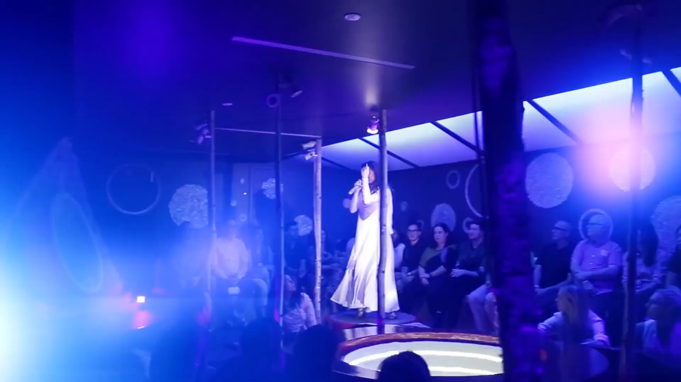
Notes:
You don’t have to set foot on the peninsula to enjoy K-Theatre. There is a new musical headed to Broadway called: K-Pop, composed by my musical writing colleague, Helen Park.

Slide 6
SEOUL-Y KOREAN & SOLELY AMERICAN
South Korea
Development starts in Seoul
United States
Development may start regionally
Typical run: 2-3 months
Irregular runs
Commercial industry is relatively new (50s); theatregoers are younger
Commercial industry is pioneered here (1920s); theatregoers are older
Agencies, Guilds, Unions
Agencies
“You’re just thrown out in the wilderness. You have to find your own way to survive here.”
“We like to derive and do crazy stuff… We’re finding out own voice and our own style.”
“The way they make musicals in the West is a little more... simple and rigid… by the book.”
Notes:
There are major differences between the Korean and American commercial industry. Broadway, Off-Broadway, Off-Off-Broadway pioneered the industry in the 1920s. Daehangno and the National Theatre of Korea started in the 1950s following the war. The audience is based on that. Soovin, who has experienced Broadway theatres, states: “We like to derive and do crazy stuff… We’re finding our own voice and our own style.”
Big shows are typically ₩24,000,000,000 or $20,000,000, so not much different from the costs of New York.
And there are many paths in the states while almost all workshops start in Seoul. And South Korea does not have unions like Actors' Equity or SAG-AFTRA.
To conclude this hot topic, I asked the coolest artist in the industry of any advice she would give to an up-and-coming producer.

Slide 7
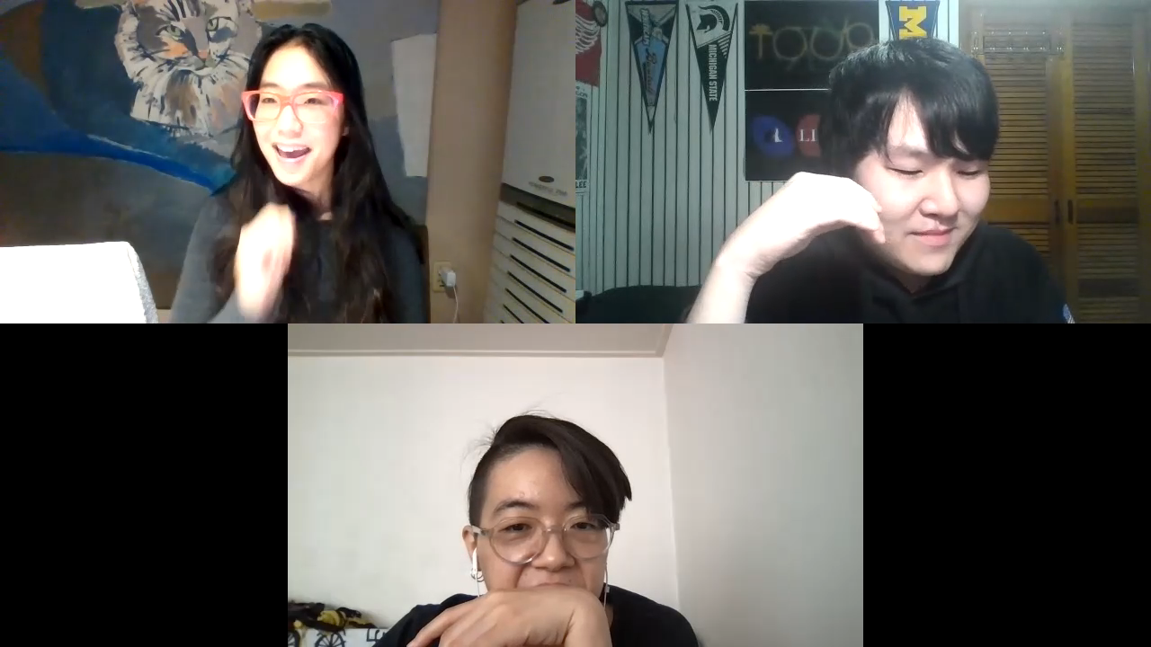

Slide 8
감사합니다
THANK YOU
Notes:
gam sa mi da

